Slide 1
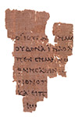
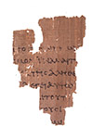
John 18.39-19.16a
“P52”
photo: The Center for the Study of New Testament Manuscripts [csntm.org]
rights: John Rylands Library in Manchester, England

Slide 2
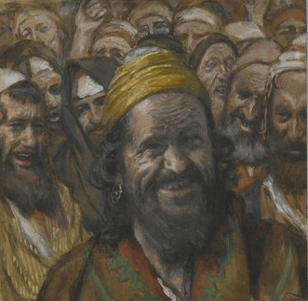
John 18.39-40 NET: “But it is your custom that I release one prisoner for you at the Passover. So do you want me to release for you the king of the Jews?” Then they shouted back, “Not this man, but Barabbas!” (Now Barabbas was a revolutionary.)
“Barabbas” by James Tissot
BrooklynMuseum.org

Slide 3
John 18.39-40 NET: “But it is your custom that I release one prisoner for you at the Passover. So do you want me to release for you the king of the Jews?” Then they shouted back, “Not this man, but Barabbas!” (Now Barabbas was a revolutionary.)
λῃστής
robber or revolutionary guerilla
Mark 15.7 NET: A man named Barabbas was imprisoned with rebels who had committed murder during an insurrection.

Slide 4
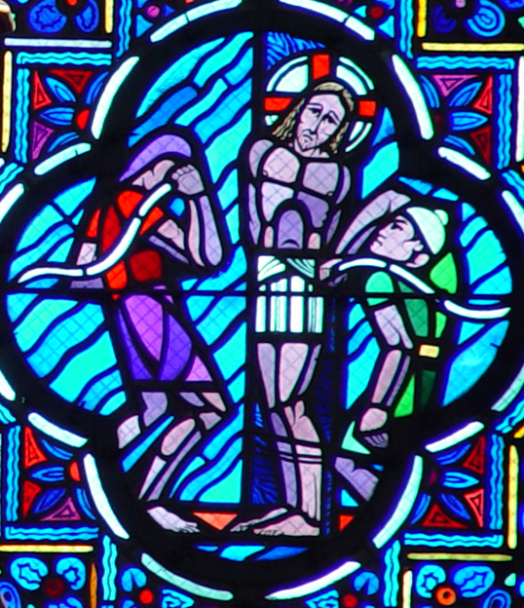
John 19.1-3: Then Pilate took Jesus and had him flogged severely. The soldiers braided a crown of thorns and put it on his head, and they clothed him in a purple robe. They came up to him again and again and said, “Hail, king of the Jews!” And they struck him repeatedly in the face.
“Flogging of Christ by Soldiers”
Le Breton & Gaudin
Cathedrale d’Amiens / vanderbilt.edu

Slide 5
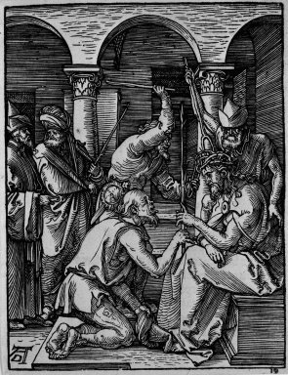
John 19.4-5: Again Pilate went out and said to the Jewish leaders, “Look, I am bringing him out to you, so that you may know that I find no reason for an accusation against him.” So Jesus came outside, wearing the crown of thorns and the purple robe. Pilate said to them, “Look, here is the man!”
“Christ Crowned with Thorns”
Albrecht Dürer
BrooklynMuseum.org

Slide 6
John 19.6-7: When the chief priests and their officers saw him, they shouted out, “Crucify him! Crucify him!” Pilate said, “You take him and crucify him! Certainly I find no reason for an accusation against him!” The Jewish leaders replied, “We have a law, and according to our law he ought to die, because he claimed to be the Son of God!”
Depth of hatred
Reason for hatred

Slide 7
God
The king, like a son, would reflect God’s character and represent God to the people of Israel.
Israel, following their king, would reflect God’s character and represent God to the nations.
Jesus claimed to be God’s chosen king and the divine Son of God!
Israel
King
Nations

Slide 8
John 19.8-11: When Pilate heard what they said, he was more afraid than ever, and he went back into the governor's residence and said to Jesus, “Where do you come from?”
But Jesus gave him no answer.
So Pilate said, “Do you refuse to speak to me? Don't you know I have the authority to release you, and to crucify you?”
Jesus replied, “You would have no authority over me at all, unless it was given to you from above. Therefore the one who handed me over to you
is guilty of greater sin.”

Slide 9
“You would have no authority over me at all,
unless it was given to you from above.”
How much of what happens is by human free will, and how much is part of God’s sovereign plan?
How can the answer bring us inner peace?

Slide 10
“Therefore the one who handed me over to you
is guilty of greater sin.”
God
God
Israel
King
Israel
Priest
Nations
Nations

Slide 11
Christ is head of the church; will you trust in him or in the ways of the world when you are struggling?
God
God
Church
Christ
Church
Christ
Peoples
Peoples

Slide 12
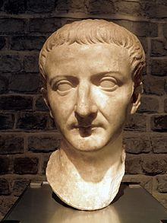
John 19.12-13: From this point on, Pilate tried to release him. But the Jewish leaders shouted out, “If you release this man, you are no friend of Caesar! Everyone who claims to be a king opposes Caesar!” When Pilate heard these words he brought Jesus outside and sat down on the judgment seat in the place called “The Stone Pavement” (Gabbatha in Aramaic).
“Tiberius”
Carole Raddato
Romisch Germanisches Museum [Cologne]

Slide 13
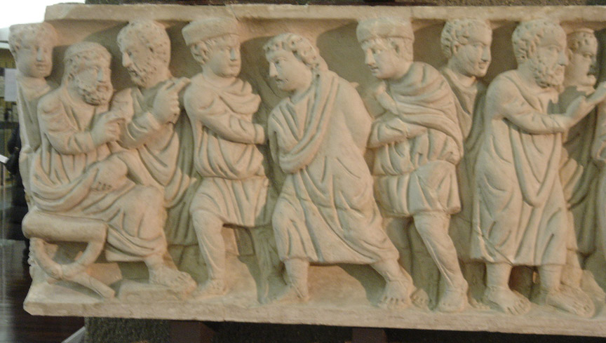
John 19.14-16: (Now it was the day of preparation for the Passover, about noon.) Pilate said to the Jewish leaders, “Look, here is your king!” Then they shouted out, “Away with him! Away with him! Crucify him!” Pilate asked, “Shall I crucify your king?” The high priests replied, “We have no king except Caesar!” Then Pilate handed him over to them to be crucified.
“Jesus before Pilate” / Sarcophagus fragment / Vanderbilt.edu

